Slide 1
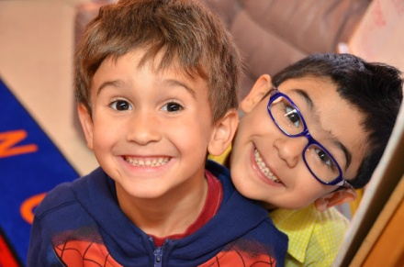
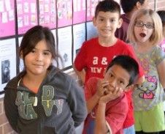



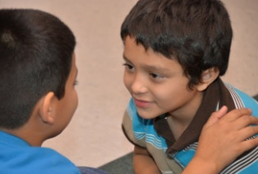

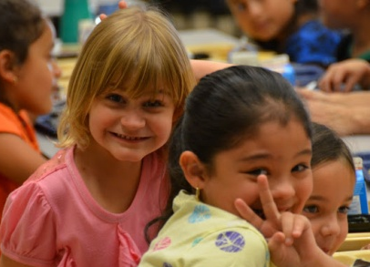
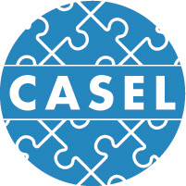
Building Supportive School Communities:
The Impact of Social, Emotional Learning, and Equity
  IIRP’s 23rd World Conference: Learning in the 21st Century:
  A Restorative Vision
  October 24, 2017
  Dr. Pamela Randall-Garner

Slide 2
Presentation Objectives
Share CASEL’s definition of SEL and explain why SEL is essential for high quality education.
Cite SEL research and its connections to academic achievement, positive student development, and reductions in negative behaviors and emotional distress.
Discuss the alignment of SEL and Equity and how districts are adding effective strategies like Restorative Practices into school and district policies

Slide 3
Let’s Start with the End in Mind
What knowledge, skills, and attitudes do we want students to possess by the time they graduate from high school in order to thrive in the 21st century?
Notes:
STRATEGY: This is a strategy that could be taken back to a school or district
The skills we have listed are primarily SEL skills that we value but have not been intentionally and systemically teaching. As we move forward, let’s think about how we could become more intentional in our teaching.

Slide 4
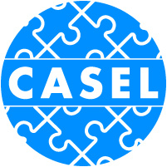
The Collaborative for Academic, Social, and Emotional Learning was founded in 1994 to make social and emotional learning (SEL) an essential part of every young person’s education by:
    Advancing the science of SEL
    Expanding effective SEL practice
    Improving state and federal policies
“CASEL’s mission is to help make evidence-based social and emotional learning (SEL) an integral part of education from preschool through high school.”
Notes:
4

Slide 5
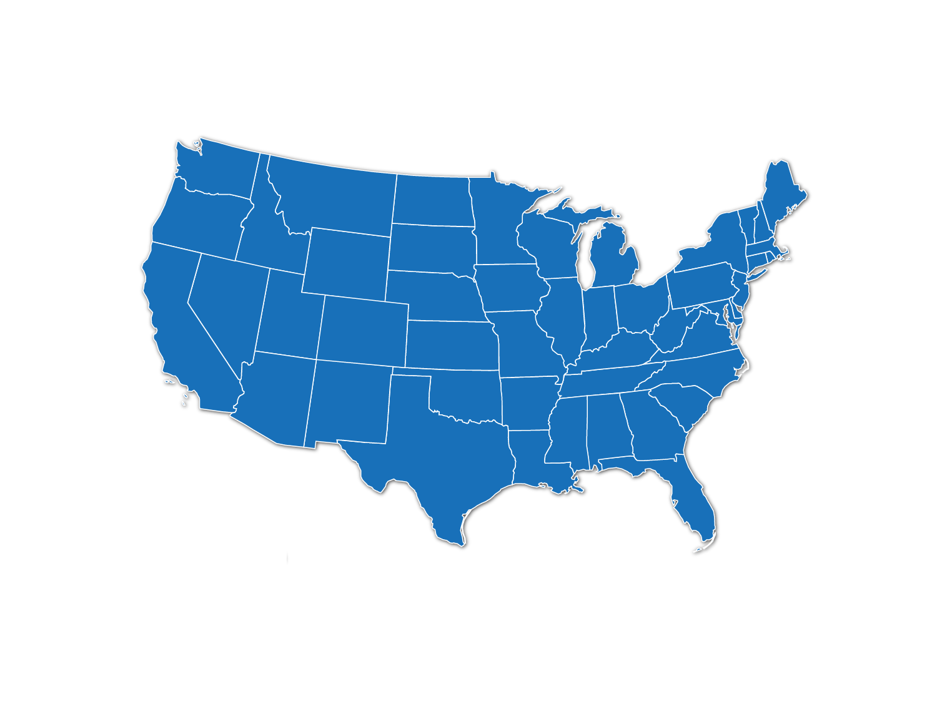





About CASEL’s
Collaborating Districts Initiative
Partnering with large urban school districts to implement district-wide SEL.
Anchorage, AK
Atlanta, GA
Austin, TX
Boston, MA
Chicago, IL
Cleveland, OH
Dallas, TX
Denver, CO
El Paso, TX
Minneapolis, MN
Nashville, TN
Oakland, CA
Palm Beach County, FL
Sacramento City, CA
Tacoma, WA
Tulsa, OK
Washoe County, NV

Slide 6
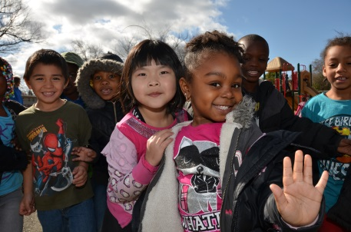
What is
Social and Emotional Learning?
SEL involves processes through which children and adults develop fundamental emotional and social competencies to understand and manage emotions, set and achieve positive goals, feel and show empathy for others, establish and maintain positive relationships, and make responsible decisions.
Notes:
Options: Pick out the words that speak to you. Ask someone to read the definition.

Slide 7

“Five Keys to Successful SEL”
https://www.youtube.com/watch?v=DqNn9qWoO1M
As you watch this video, think about the following:
What are students doing?
What do adults say about SEL?
How would SEL look in your school?
Notes:
As Goethe said, “In the actual is a glimpse of the possible.” We want to start off our workshop by immersing us in a glimpse of SEL in action.
As you watch this video clip, please pay attention to examples of district commitment, SEL instruction, adult SEL competence, and integration of SEL into a variety of aspects of school life. Be prepared to share examples during the large group discussion that will follow.

Slide 8
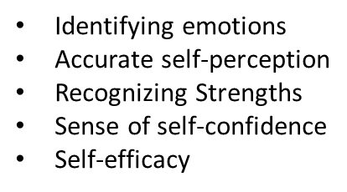
Levels of Schoolwide SEL
FAMILY, & COMMUNITY PARTNERSHIPS
FAMILY & COMMUNITY PARTNERSHIPS
Impulse control
Stress management
Self-discipline
Self-motivation
Goal setting
Organizational skills
SEL CURRICULUM & INSTRUCTION
SCHOOLWIDE PRACTICES & POLICIES
SEL CURRICULUM & INSTRUCTION
SELF-MANAGEMENT
SELF-AWARENESS
Perspective-taking
Empathy
Appreciating diversity
Respect for others
Social and
Emotional
Learning
(SEL)
Problem identification
Situation analysis
Problem-solving
Evaluation
Reflection
Ethical responsibility
SOCIAL AWARENESS
RESPONSIBLE DECISION-MAKING
SEL CURRICULUM & INSTRUCTION
RELATIONSHIP SKILLS
Communication
Social engagement
Building relationships
Working cooperatively
Resolving conflicts
Helping/Seeking help
SCHOOLWIDE PRACTICES & POLICIES
Notes:
REFERENCE THE APPENDIX: Wheel & Comptencies
CASEL has identified five SEL core competency clusters: self-awareness, self-management, social awareness, relationship skills, and responsible decision making. Each of these areas has specific knowledge, skills, and dispositions that fortify the ability to demonstrate these competency clusters.
Some of the teams here today saw a video that introduced the Five SEL Core Competencies when you met with your coach in the spring.
There are three key levels of support for schoolwide SEL: SEL Curriculum and Instruction ; Schoolwide Practices and Policies, and Family and Community Partnerships.
SEL Curriculum and Instruction includes:
Integrating SEL with CCSS and instructional practices
Explicit instruction of SEL skills
Integrating and learning through assessment
Schoolwide Practices and Policies
Approaches and strategies that promote SEL throughout the school
Building a safe and supportive climate
Adults modeling SEL competencies
Family and Community Partnerships
Engaging and partnering with families and the community

Slide 9
Why Is SEL
Important?

Slide 10
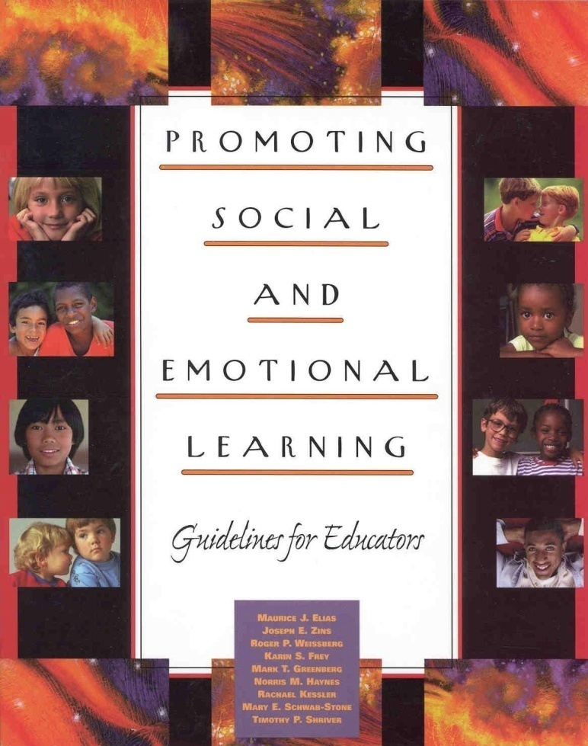
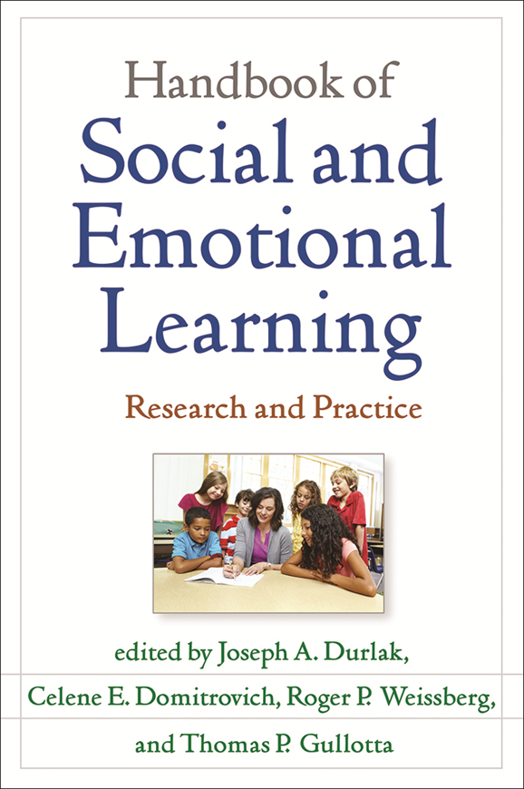
1997: CASEL Defines the Field of SEL
2015: Current and Future Perspectives on
Social and Emotional Learning
Notes:
10

Slide 11
SEL Improves Student Outcomes
Science Links SEL to Student Gains:
    Social-emotional skills
    Improved attitudes about self, others, and school
    Positive classroom behavior
    11 percentile-point gain on standardized achievement tests
And Reduced Risks for Failure:
    Conduct problems
    Emotional distress
Source: Durlak, J.A., Weissberg, R.P., Dymnicki, A.B., Taylor, R.D., & Schellinger, K. (2011) The impact of enhancing students’ social and emotional learning: A meta-analysis of school-based universal interventions. Child Development: 82 (1), 405-432.
Notes:
11
11
Let’s take a look at the research that shows that SEL impacts a number of positive student outcomes., including academic achievement. Please take out the research summary in the left pocket of your older called, “Benefits of School-Based SEL Programs: Highlights from a Major New Study.” Much of this information in included in the summary.
[click] Science links SEL to student gains, such as socio-emotional skills; improved attitudes about self, others, and school; positive classroom behavior; and 11-percentile gain on standardized achievement tests.
[click] And Reduced Risks of Failure, such as fewer conduct problems and less emotional distress.
Child Development – an important, peer-reviewed journal – published this landmark study. The team of Joe Durlak at Loyola University, CASEL President and CEO Roger Weissberg, and graduate students from Loyola and the University of Illinois at Chicago analyzed 213 school-based studies involving 270,034 students.

Slide 12
A Conceptual Framework for Enhancing Students’ Social and Emotional Learning
SEL Approaches:
Explicit SEL Skills Instruction
Integration with Academic Curriculum Areas
Teacher Instructional Practices
Organizational, Culture, and Climate Strategies
SEL Skill Acquisition:
Five Competence Areas
Positive Social Behavior
Fewer Conduct Problems
Improved Attitudes:
Self, Others, Learning, and Schools
Less Emotional Distress
Enhanced Learning Environment: Supportive, Engaging, and Participatory
Improved Academic Performance

Slide 13
SEL as a Predictor of Future Wellness
Results of a recent study show statistically significant associations between kindergarteners’ SEL skills and key young adult outcomes across multiple domains:
Kindergarteners who were stronger in SEL competence were more likely to:
  Graduate from high school
  Complete a college degree
  Obtain stable employment in young adulthood
And less likely to be:
  Living in public housing
  Receiving public assistance
  Involved with police
  In a detention facility
Jones, Damon E. , Greenberg, Mark and Crowley, Max (2015). Early Social-Emotional Functioning and Public Health: The Relationship between Kindergarten Social Competence and Future Wellness. American Journal of Public Health, Vol. 105, No. 11, pp. 2283-2290.

Slide 14

21st Century and Workforce Skills
On the SCANS Report, half of the 16 skills are social and emotional in nature and are considered essential to life success.
Skill categories include:
    Self-esteem
    Integrity
    Self-management
    Sociability
    Responsibility
    Listening
    Decision-making
    Problem solving
Partnership for 21st Century Skills
Notes:
In addition, SEL is not only important for helping our students be successful now, but also for the future. SEL prepares students for the workforce –with 21st Century Skills. SEL is not only important for helping our students be successful now, but also for the future.
The SCANS Skills and Competencies: an Overview - On the SCANS Report, half of the 16 skills are social emotional related and are considered essential, such as [read the eight skills listed on the slide.]
The Secretary's Commission on Achieving Necessary Skills (SCANS) was appointed by the Secretary of Labor to determine the skills our young people need to succeed in the world of work. The Commission's fundamental purpose is to encourage a high-performance economy characterized by high-skill, high-wage employment. The primary objective is to help teachers understand how curriculum and instruction must change to enable students to develop those high performance skills needed to succeed in the high performance workplace. SCANS has focused on one important aspect of schooling: what they called "learning a living" system. In 1991, they issued their initial report, What Work Requires of Schools. As outlined in that report, a high-performance workplace requires workers who have a solid foundation in the basic literacy and computational skills, in the thinking skills necessary to put knowledge to work, and in the personal qualities that make workers dedicated and trustworthy. High-performance workplaces also require other competencies: the ability to manage resources, to work amicably and productively with others, to acquire and use information, to master complex systems, and to work with a variety of technologies. This document outlines both these "fundamental skills" and "workplace competencies"
Source: US Department of Labor. (1999). Secretary's commission on achieving necessary skills (SCANS) report: What work requires of schools. Retrieved March 17, 2005, from http://wdr.doleta.gov/scans
34

Slide 15
At age 21—15 years after participating in a high-quality SEL program—Seattle young people still outpaced their peers:¹
SEL Pays Off Long-Term
Higher HS graduation and college attendance
Better rates of employment and economic status
Better emotional and mental health
Fewer with criminal record and substance problems
Cost-benefit: $2.11/student for $1.00 invested²
Sources:
Hawkins, J. D., Kosterman, R., Catalano, R.F., Hill, K.G., Abbott, R.D. (2005). Positive Adult Functioning Through Social Development Intervention in Childhood: Long-Term Effects from the Seattle Social Development Project. Archives of Pediatrics & Adolescent Medicine, 159 (1), pp. 25-31.
Aos, S., Lieb, R., Mayfield, J., Miller, M., , Pennucci, A. (2004). Benefits and Costs of Prevention and Early Intervention Programs for Youth. Washington State Institute for Public Policy. Accessed from http://www.wsipp.wa.gov/rptfiles/04-07-3901.pdf.
Notes:
15
SEL pays off in the long term. The Seattle Social Development Project conducted a longitudinal study over 15 years.
Citation: Hawkins, J. D., Kosterman, R., Catalano, R.F., Hill, K.G., & Abbott, R.D. (2008). Effects of social development intervention in childhood 15 years later. Archives of Pediatric and Adolescent Medicine, 162, 1133-1141.

Slide 16
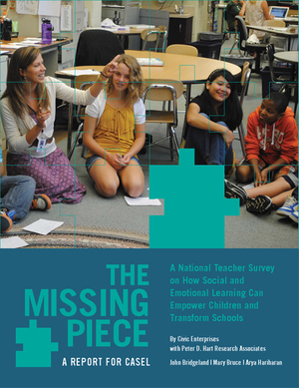

Slide 17
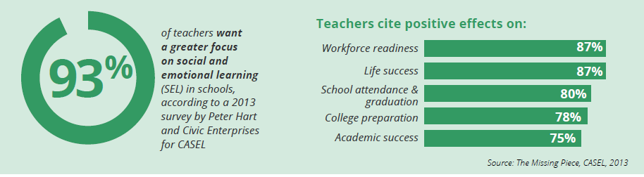
Teachers Value SEL
of teachers want a greater focus on social and emotional learning (SEL) in schools, according to a 2013 survey by Peter Hart and Civic Enterprises commissioned by CASEL
Notes:
17

Slide 18
But what else is missing from the discussion?
Equity and SEL

Slide 19

So how can we help districts be more thoughtful in developing effective, integrated practices and policies to support achievement of all students?

Slide 20
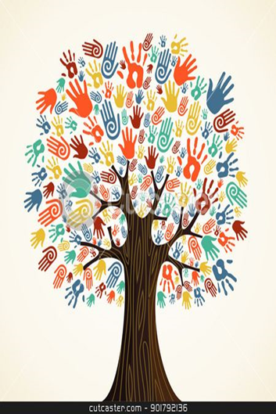
CASEL Equity Work Group 2016
EWG Convenings
Research and Practitioner Panels
Webinars/Book Studies
Cross-District Annual Conference
Strong Professional Learning Community

Slide 21
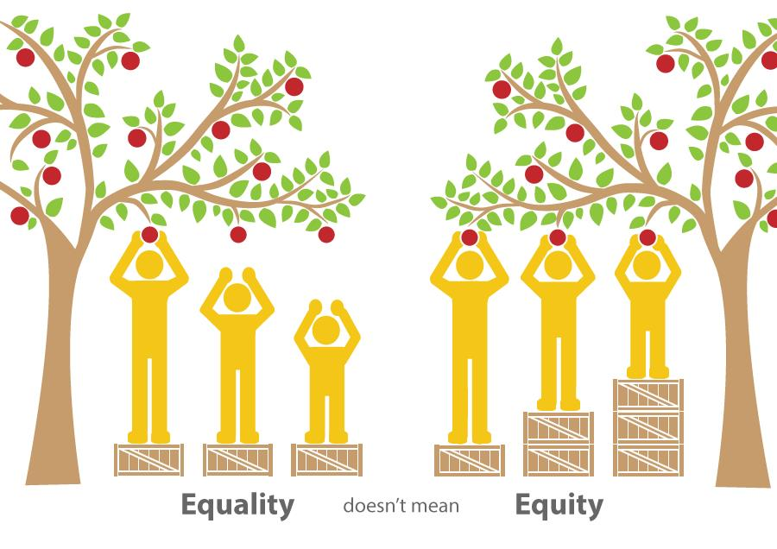
Equity and SEL District Challenges
Discipline Disparities
Students feeling unsafe and disconnected from school
Academic and behavior issues
Hiring and on-boarding practices were not effective

Slide 22




Districts’ Responses to Equity/SEL Challenges
District Policy to reduce suspensions
Restorative Practices
Culturally responsive teaching in SEL
HR practices and policy changes
Collaboration across departments
School/Community Task Force

Slide 23



Three signature SEL practices for the classroom create the conditions for student learning
Welcoming Ritual (2-10 minutes)- Activities for inclusion, establish safety and predictability, allow students to connect with one another and create a sense of belonging. Activities are connected to the learning of the day.
Engaging Practices- Academic integration, sense- making, transitions and “brain breaks” foster relationships, cultural humility, empowerment, and collaboration.
Optimistic Closure (3-5 minutes)- Reflections and looking forward provides intentional closure by asking students to name something that helps them transition on a positive note.
Ann McKay Bryson, CASEL Professional Learning Consultant for the OUSC Office of Social and Emotional Learning

Slide 24
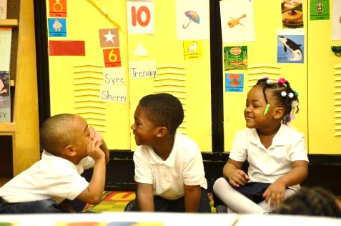
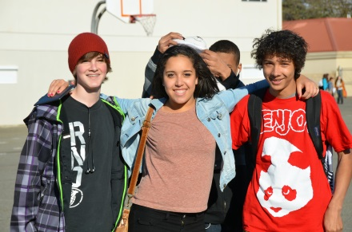
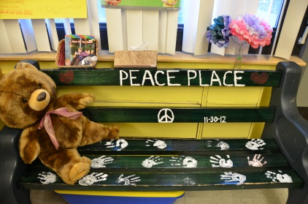
Share your story…
When a school makes the social and emotional development and well-being a priority for every student:
What are students and school staff doing in the office, in the lunchroom, in hallways, and in classrooms ?
What Restorative Practices are you seeing implemented?
What culturally responsive teaching practices do you see?
What does an environment that is intellectually and socially safe for learning look like?
Now imagine this for every student at your school….
Notes:
Now imagine this for every student at every school….. What do you do next?

Slide 25
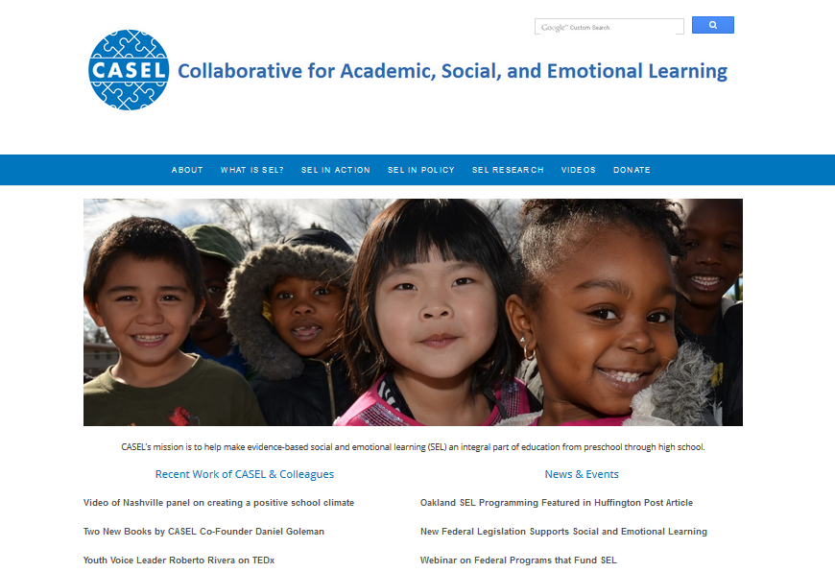


www.casel.org
prandall-garner@casel.org
@caselorg
Notes:
Presenters should add their contact info to this slide.

