Slide 1






Social Emotional Learning, Positive Behavioral Intervention and Supports, and Restorative Practices in Atlanta Public Schools
2018 IIRP World Conference Presentation
Comprehensive School Safety Initiative (CSSI) Grant Program
October 24, 2018 – Detroit, Michigan

Slide 2
This project was supported by Award Number 2015-CK-BX-K001, granted by the National Institute of Justice, Office of Justice Programs, U.S. Department of Justice. The opinions, findings, and conclusions or recommendations expressed in this presentation are those of the authors and do not necessarily reflect those of the Department of Justice.

Slide 3







The APS Way…
Social Emotional Learning (SEL)
Positive behavioral interventions & supports (PBIS)
Restorative Practices (RP)

Slide 4



What is Social Emotional Learning?
5 core competencies
of Social Emotional Learning
What is SEL?
Social and emotional learning (SEL) involves processes through which children and adults develop fundamental emotional and social competencies to understand and manage emotions, set and achieve positive goals, feel and show empathy for others, establish and maintain positive relationships,
and make responsible decisions.

Slide 5
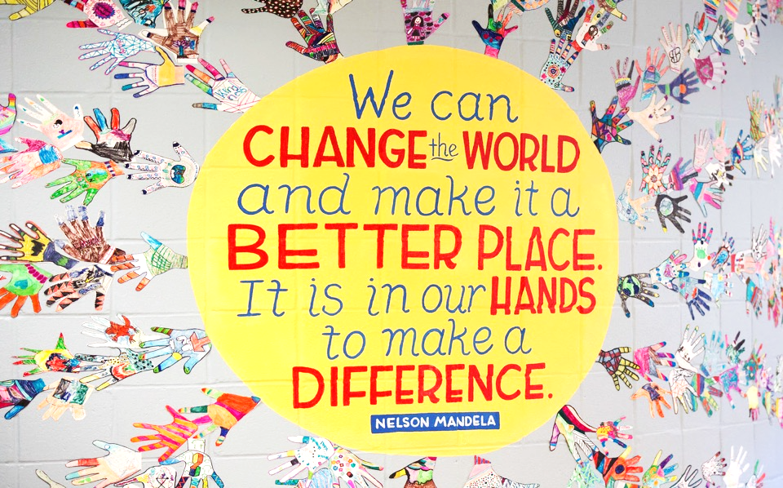
A Bold New Direction

Slide 6
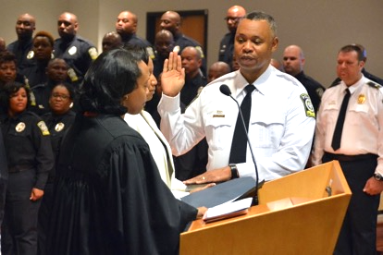
Our Commitment
We are committed to encouraging student success by helping to ensure all schools have the support needed to facilitate safe, secure, and supportive spaces that maximize teaching and learning.
Photo: Ronald Applin being sworn in as the first Chief of Police for the Atlanta Public Schools Police Department. (July 2016)

Slide 7

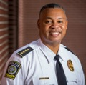

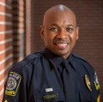
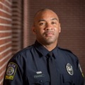
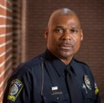
Who we are…
Office of Safety & Security Leadership
Row #1: Ronald Applin, APSPD Chief of Police;
Ralph Velez, Security Operations Director
Row #2: Commander Taras Holloman;
Commander Curtis Adams; Lieutenant Melvin Hill

Slide 8
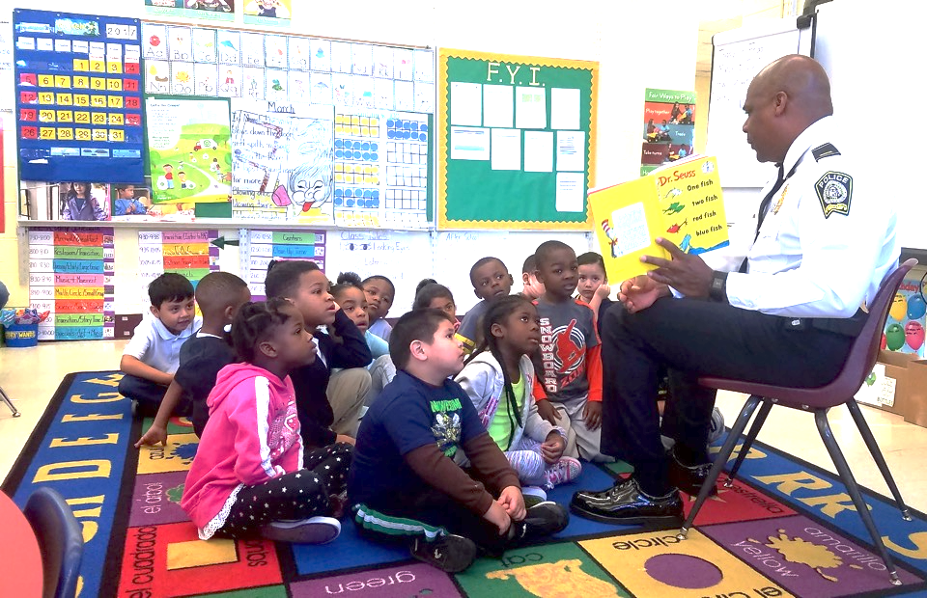
What we believe…

Slide 9

What we believe…
We believe that all students can achieve when they are supported and nurtured in a
SAFE. SECURE. STRONG. learning environment.
Photo: Proud graduate of the Frederick Douglass High School Class of 2017. (May 2017)

Slide 10

Our Mission & Vision

Slide 11
Our Mission & Vision
Mission: With the highest level of professionalism, create a safe and secure environment for teaching and learning.
Vision: A national leader in school safety and security services.
Motto: #SafeSecureSTRONG!

Slide 12
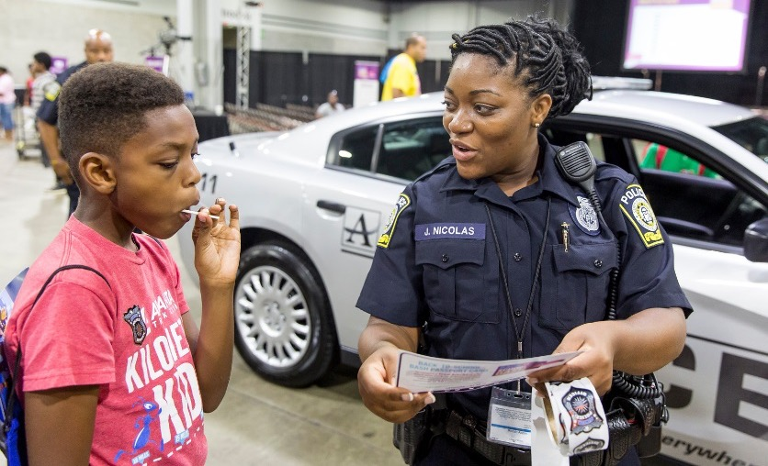
APSPD Public Safety Unit
…Did you know?
  The APS Police Department has 70+ sworn-officers with authority to enforce all laws, make arrests, and issue tickets.
  The APSPD Dispatch Command Center is available 24/7 for emergency and non-emergency calls.
  APS has over 60 School Crossing Guards covering more than 65 crosswalk locations.

Slide 13
APSPD Public Safety Unit
Key Responsibilities:
  APSPD School Resource Officers (SROs) support elementary, middle, and high schools.
  APSPD responds to school safety concerns and crisis incidents on APS campuses and workplaces.
  SROs serve as safety coordinators for all middle and high schools and support designated safety coordinators in elementary schools.
  School Crossing Guards (SCGs) assist with pedestrian safety at APS elementary schools.

Slide 14
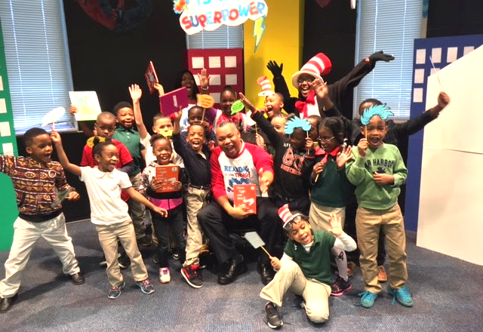
Key Accomplishments

Slide 15



Key Accomplishments
National Institute of Justice (NIJ) $7,500,000 to develop and implement a research-based Comprehensive School Safety Initiative (CSSI) framework in partnership with WestEd & Georgia State University for safe and supportive schools across APS.
The Annie E. Casey Foundation Grant
$40,000 to improve relationships between officers and students and fund Restorative Practices training.
The Hartford Grant
$10,000 to start a Junior Fire Marshal Program promoting fire safety and prevention training for students in grades K-3.

Slide 16



Key Accomplishments
Social Emotional Learning
100% of APSPD school resource officers (SROs)
have received SEL training.
Restorative Practices
APSPD is one of the only police departments in Georgia and one of the few police departments in
the nation trained in Restorative Practices.
Crisis Intervention Team Youth (CIT-Y)
APSPD is the first school district police agencies in Georgia to certify 100% of its officers in trauma-informed CIT-Y training.

Slide 17
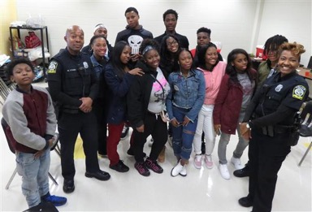
RP in Action @ APS: Douglass HS
“Officer Dixon and I use proactive restorative circles regularly at Douglass High School as part of our mentoring program. Most of our circles are non-sequential, allowing the students to speak when they have something to say. We believe this gives the student a more free, structured discussion. Most of the students really open-up, and they enjoy expressing themselves. Last week we conducted a circle in reference to "group” fighting. The students really had a great conversation and they vocalized their feelings; some even cried.
Officer Dixon and I love conducting proactive
restorative circles because they truly work.
We stopped a shooting last year in Allen Temple
Apartments because of a circle we conducted at
Douglass High School at the request of a
concerned parent.
Last year we conducted one or two circles a week
at Douglass High School and we are on track to
continue that pace.”
Officer Mario Young (FTO)
School Resource Officer
Douglass High School
Photo: Frederick Douglass High School APSPD School Resource Officers (SROs) with mentoring group, Fabulous, Determined, High-achieving, Students (FDHS).

Slide 18
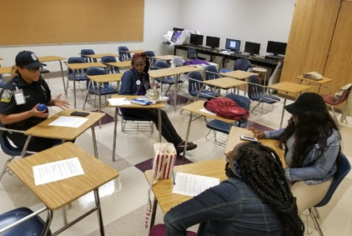
RP in Action @ APS: South Atlanta HS
“I have an example of when restorative practices was used to resolve a conflict between three female students at South Atlanta High School. On September 6, 2017 Officer Williams and I conducted a circle to show them how to resolve conflict without fighting. These students were originally friends, but because of a social media rumor, they wanted to fight each other. Originally they refused to talk to each other and just wanted to fight. I convinced the girls to come together and trust the process.
After a little resistance in the beginning of
the circle, they began to express how each
one’s actions made them feel. They were
able to conclude that their issue wasn’t
serious enough to lose friendships or fight
over. At the end of the circle, the girls were
hugging and agreed to talk through any
other issues they may have instead of
becoming violent. Conflict resolved through
Restorative Practices.”
Officer Jennifer Maxey
School Resource Officer
South Atlanta High School
Photo: South Atlanta High School APSPD School Resource Officer with students participating in a restorative circle to resolve a conflict.

Slide 19
Safe & Supportive Schools?
Defining Safe & Supportive Schools
“Our vision of safe schools is one where students feel free to focus on their learning, unburdened by concerns about being bullied or victimized by violent incidents, or having property damaged or stolen. Safe schools emerge when students, staff, parents, and community members are actively engaged in the learning and social environment. Ultimately, there is a reciprocal relationship between an engaged school community and schools that are safe and supportive.”
                McCrary, Grogan, Henrich, Terrell, Estacion, Persson, Malm, & Cleary (2016)

Slide 20
Safe & Supportive Schools Model
ACHIEVEMENT
WELL-BEING
POSITIVE BEHAVIOR
FAMILY
ENGAGEMENT
COMMUNITY ENGAGEMENT
Safe & Supportive Schools
ENGAGEMENT
PHYSICAL ENVIRONMENT
NORMS & POLICY
CONNECTEDNESS
FEELINGS OF SAFETY
SCHOOL CLIMATE DOMAINS
Notes:
The safe and supportive schools explanatory model still stands for further detail on the core.

Slide 21
How do we get to a safe and supportive school?
Path to Safe & Supportive Schools
Community
District
School & Cluster
Knowledge & Skills
Foundational Practice
School Board
Specialization
Needs Assessment
Intervention Success Model

Slide 22
APS Needs Assessment
Components:
  School Safety & Support Profile
      Georgia Health Survey
  School Characteristics
      District
  Behavior Incidents & Responses
      State Collected
  Student Achievement
      CCRPI
  APSPD Incidents
  Stakeholder Perceptions
      Staff, students, parents, and community surveys administered by WestEd and Georgia State

Slide 23
APS Stakeholder Perceptions
District-wide Surveys:
School Resource Officers
(n = 60)
School Administrators
(n = 109)
Role | N | Percentage
SRO High School | 23 | 38%
SRO Middle School | 13 | 22%
Rover | 7 | 12%
Alarm Response Officer | 4 | 7%
APSPD Command | 4 | 7%
Investigator | 3 | 5%
Training Officer | 1 | 2%
Other | 5 | 8%
Total | 60 | 100%
Role | N | Percentage
Principal | 66 | 61%
Assistant Principal | 43 | 39%
Total | 109 | 100%
Source: Comprehensive School Safety Initiative – School Resource Officer (SRO) & School Administrator Surveys (2018)

Slide 24
SROs Value Restorative Practices
APSPD SROs were asked…
What was the most valuable professional development session you attended during the current school year?
    Restorative Practices (31%)
    Youth Mental Health (14%)
If you were starting your own SRO program in a school district, what would you replicate from your experience here at APS?
    Restorative Practices (33%)
Source: Comprehensive School Safety Initiative – School Resource Officer (SRO) Survey (2018)

Slide 25
Use of SEL & Restorative Practices
APSPD SROs were asked…
Since the beginning of this school year, how often have you used Social Emotional Learning (SEL) or Restorative Practices with students?
Source: Comprehensive School Safety Initiative – School Resource Officer (SRO) Survey (2018)

Slide 26
Overall SRO Perceptions: SEL & RP
84% of SROs agreed or strongly agreed that their training prepared them well to implement Social Emotional Learning (SEL) and Restorative Practices (RP).
80% of SROs agreed or strongly agreed that SEL and RP implementation is consistent with the training they received.
88% of SROS agreed or strongly agreed that students responded well to SEL and RP.
71% of SROs agreed or strongly agreed that student behavior improved with exposure to SEL and RP
Source: Comprehensive School Safety Initiative – School Resource Officer (SRO) Survey (2018)

Slide 27
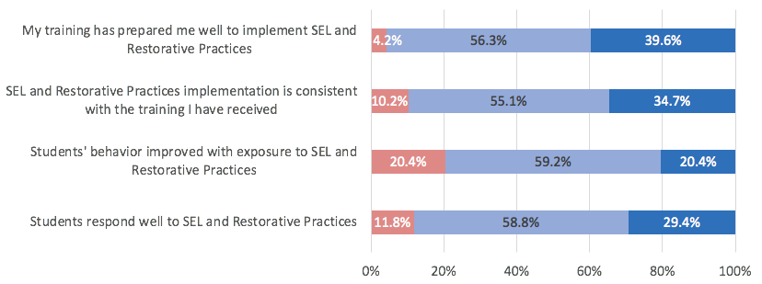
Use of SEL & Restorative Practices
APSPD SROs were asked…
Source: Comprehensive School Safety Initiative – School Resource Officer (SRO) Survey (2018)

Slide 28
SRO Perceptions: Student Interactions
85% of SROs agreed or strongly agreed that students understood their role in the school.
94% of SROs agreed or strongly agreed that students treat them with respect.
96% of SROS agreed or strongly agreed that students come to them with their problems.
All SROs reported that they felt integrated into their school’s culture and actively participate in school activities.
Source: Comprehensive School Safety Initiative – School Resource Officer (SRO) Survey (2018)

Slide 29
SRO Perceptions: Student Interactions
APSPD SROs were asked…
Source: Comprehensive School Safety Initiative – School Resource Officer (SRO) Survey (2018)

Slide 30
School Administrator Perceptions
Overall, APS school administrators reported very high levels of satisfaction with SROs:
    Survey responses highlighted positive relationships and communication with parents, students, administrators, and teaching staff.
    SROs also reported positive communication experiences.
Specific SRO functions that APS school administrators were particularly satisfied with included:
    Relationship Building (33%)
    Responsiveness (23%)
Source: Comprehensive School Safety Initiative – School Administrator Survey (2018)

Slide 31
Enhancing Understanding of SRO Role
SROs reported that school administrators and parents understood their role in the school less well than students understood it:
  85% of SROs agreed or strongly agreed that students understood their role in the school;
  71% of SROs agreed or strongly agreed that school leaders understood their role in the school;
  63% of SROs agreed or strongly agreed that parents understood their role in the school.
Findings highlight the importance of outreach and communication about SRO roles to school personnel and parents.
Source: Comprehensive School Safety Initiative – School Resource Officer (SRO) & School Administrator Surveys (2018)

Slide 32
Next Steps…
Comprehensive School Safety Initiative (CSSI)
Grant Priorities:
    Develop district-level Coordination & Integration plan (C&I) that aligns Social Emotional Learning (SEL), Restorative Practices, Positive Behavioral Interventions & Supports (PBIS), and other APS student services.
    Develop school-specific C&I plans that compare data and information about current supports with students needs.
    Provide technical assistance, professional development, and other supports as needed to promote safe, supportive schools.
    Assess the impact on student outcomes.

Slide 33
Thank You
Q&A – Additional Discussion
Comprehensive School Safety Initiative (CSSI) Grant Program

