Slide 1
RP: How Do I Teach Thee? Let Me Count the Ways… Classroom, Online, Blended!
The need for a flipped classroom
Louis Fletcher, PhD
Lea Holland, MBA, MAEd
Melissa Dashner, MSW

Slide 2

Leaders who do not act dialogically, but insist on imposing their decisions, do not organize the people - they manipulate them. They do not liberate, nor are they liberated: they oppress.
-Paulo Freire
Brazilian educator and philosopher

Slide 3
District 49’s Cultural Compass
RESPECT
We respect others for their abilities, qualities and achievements.
TRUST
We build positive relationships through honesty and openness with all stakeholders
CARE
We provide a safe and caring environment for students and staff
RESPONSIBILITY
We hold ourselves accountable for our actions

Slide 4


Overview of BRIGHT
DoDEA grant for $1.5 Mil over 5 years
Military-Connected Students
Restorative Practices
MSTC

Slide 5
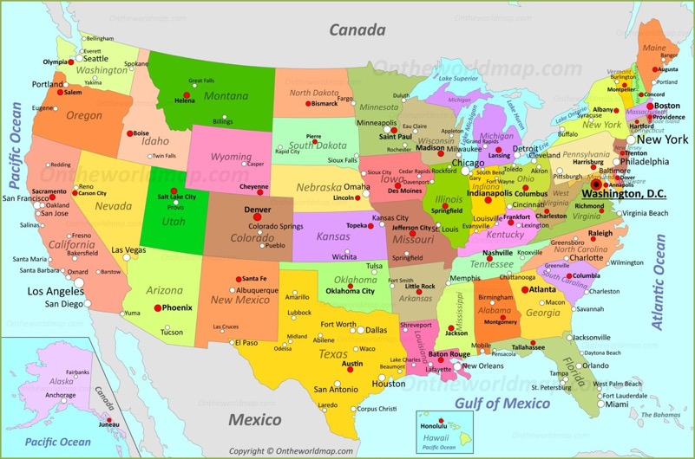
Where is District 49?

Slide 6
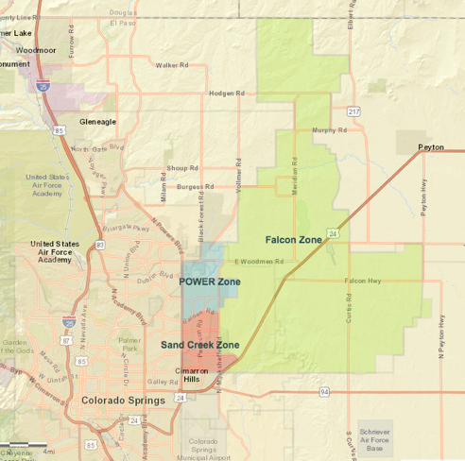
D49 Demographics
133 square miles
1,700 staff
23,000 students
22% Military (K-8)
5 Bases
  Peterson AFB
  Fort Carson
  Schriever AFB
  US Air Force Academy
  Cheyenne Mtn NORAD

Slide 7
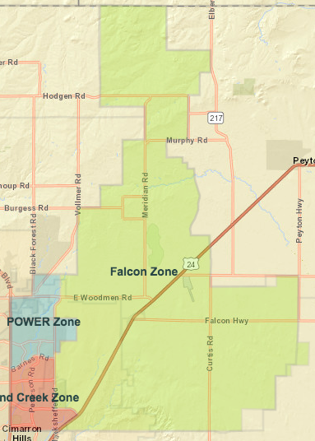
D49 Leadership
Chief officers
31 Schools
4 Zones
  Falcon
  Power
  Sand Creek
  iConnect
~ 35 miles

Slide 8
Challenges
Full school district culture shift
COMMUNITY involvement
Not a program
District paid training
  4 days per year
  Paras

Slide 9
Traditional
Created Video Lectures
Full instruction from IIRP script in Training Manual
Incorporated Training Workbook

Slide 10
Blended
Pre-work centered
  Online learning to:
    View Lectures
    Answer quiz questions
    Post in group discussions
    Complete Supplemental Reading
4 hours face to face
  1, 4 hour block
  4, 1 hour sessions during PLCs
Blended format for facilitator in Training Manual
Incorporated Training Workbook

Slide 11
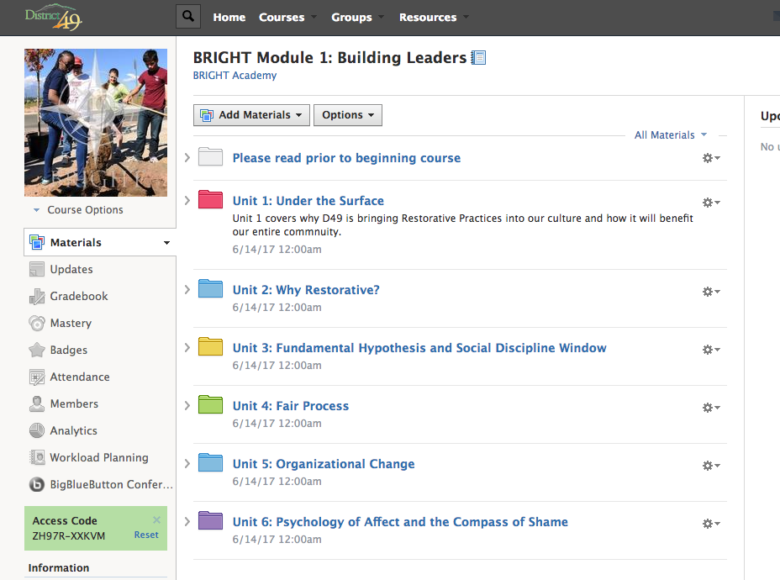

Slide 12
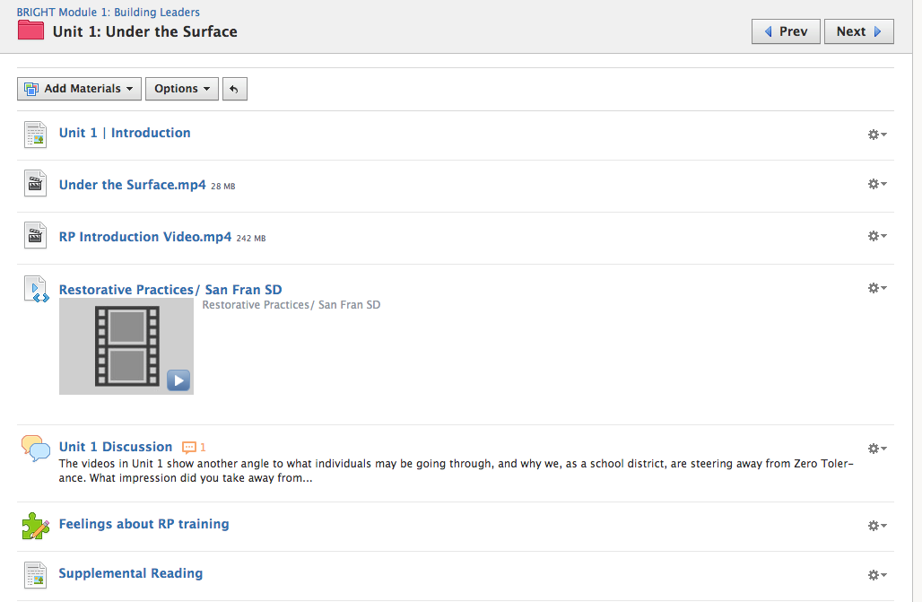

Slide 13
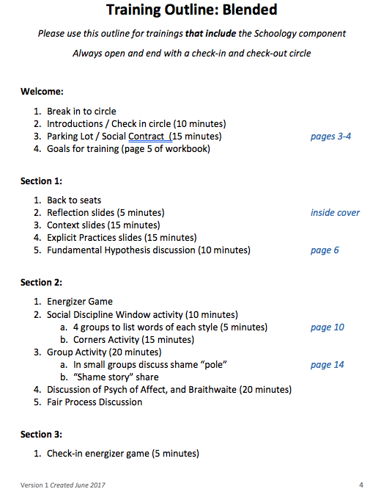

Slide 14
Online
Under Construction
Virtual Reality
D49 cultural: Self- paced learning
Online MUST be:
  Interactive
  Engaging

Slide 15

Professional Learning
Adults learn best when learning…
  Is self-directed
  Builds off of experiences
  Is relevant
  Is goal-oriented
  Is pragmatic
  Is collaborative
RP | Full Implementation
Pair and Share
Now that we’ve talked about our situation and challenges, take 5-minutes within your groups, talk about how RP implementation at your school or organization.
How might that look?
What are your opportunities and challenges?
How would you reach … teach the masses?

Slide 16
Summary
D49 Cultural Compass
BRIGHT grant
Demographics and Leadership
Challenges
Traditional, blended and online modalities
Adult Learning

Slide 17
Liberating education consists in acts of cognition, not transferals of information.
-Paulo Freire

