Slide 1
Transform Trauma-related behavior in children by “ACT”ing restorative
Sharon Mast, Instructor/facilitator
Iirp World conference,
Kortrijk, Belgium May 16, 2019

Slide 2
John joseph powell
It is an absolute human certainty that no one can know his own beauty or perceive a sense of his own worth until it has been reflected back to him in the mirror of another loving human being.

Slide 3
Fact or crap
According to a 2013 Grantmakers for Education report, 30% of English learners’ families had incomes that were 185 percent below poverty level.
We tend to demonstrate much more evidence of energy & relationship when things are going wrong instead of producing that energy & relationship in responses to success.
Meltdowns & emotional outbursts are more common in children who struggle with attachment disorders.
In the U.S., 35% of girls in juvenile justice facilities have experienced early physical, emotional or sexual abuse.
Notes:
CRAP,
FACT (Grove & Glaser, 2007, research on the nurtured heart of educators.
FACT
CRAP – 85%

Slide 4
What we know
Most educators have little or no formal education working with students and families who represent cultural, linguistic, racial and economic experiences that are distinct from our own.
(Bransford, Darling-Hammond & Lepage, 2005)

Slide 5
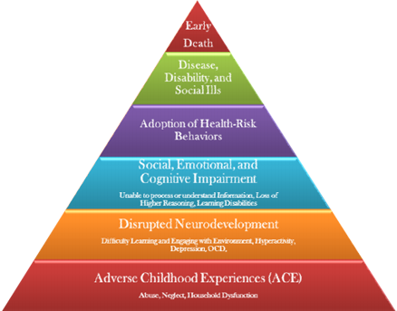
Adverse Childhood Experiences (ACEs)
Physical, Emotional & Sexual Abuse
Physical or Emotional Neglect
Family Drug & Alcohol Abuse
Domestic Violence
Incarceration
Mental Health Problems
Notes:
First study in US in 1997. Multiple studies since including England, Ukraine, Romania, Czech Republic, Macedonia, Maldova, Poland, etc

Slide 7
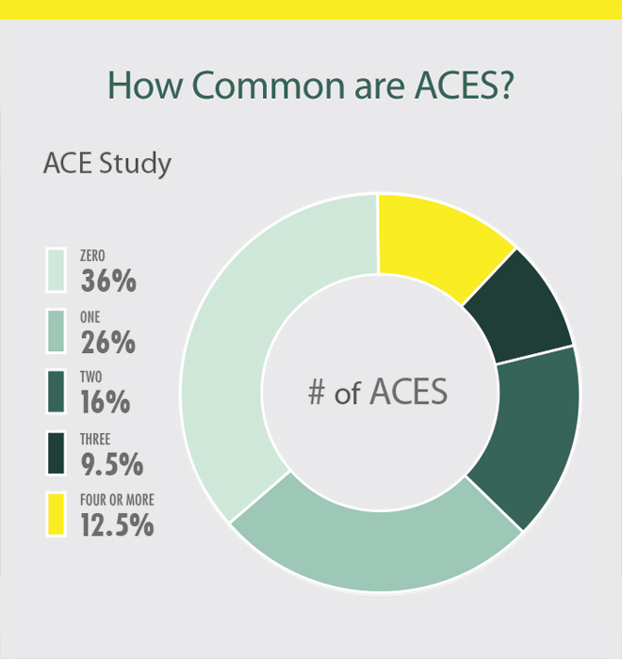
The results
Children with an ACE score of 4, experiences a 1350% increase in injection drug use
Children with an ACE score of 6, the rate is increases to 4600%.
CDC Kaiser Permanente, 1997.

Slide 8
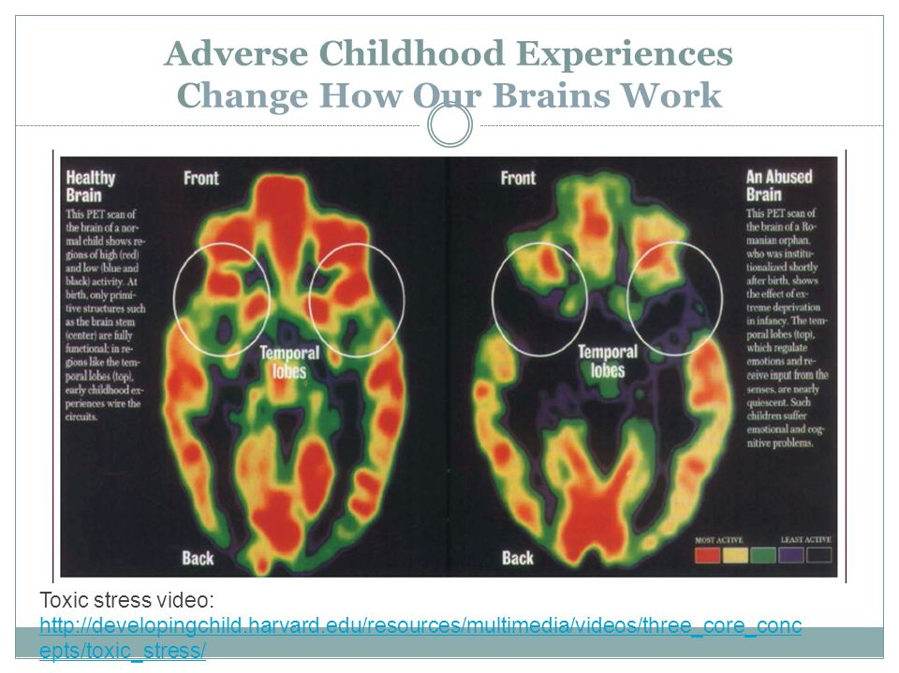
Effects on the brain
Increased anxiety & depression.
Impaired learning , concentration & memory.
Reduced attention span & control.
Difficulty experiencing joy.
Difficulty understanding the relevance of situations & how to respond.
Hypervigilant & difficulty feeling safe.
Struggle to calm down.
Limited self awareness.
Learned helplessness.
Notes:
Difficulty completing tasks started and engaging in school.
Normal relationships work on serve and return. In trauma, there is no return.
Hippocampus closes due to toxic stress. Cortisol levels increase and cannot drain off to go back to normal levels. Creates an inflammatory response and heightens the risk of affective disorders.
Myelination is the white fatty substance that insulates brain cells and ensures clear transmission of neurotransmitters across synapses. Deep sleep is needed for this to occur.
When children suffer from family or community trauma, they lose the protection of the adult world. They become hypervigilant & preoccupied with safety & survival. Everything looks like danger.
Trauma is not AN EVENT but rather a response to an experience that is so stressful that it overwhelms the individuals ability to cope.
Children do not want to be seen as disruptive or defiant. If they act out, its their way of signaling that something in their world exceeds their capacity to cope. It is our job to figure out how to improve it.

Slide 9
The act formula™
Accountability
Communication
Trust
Notes:
Helps us focus on the person first vs. the behavior. We acknowledge the behavior and its impact but when we “ACT”, our intention is to be relationship-focused, strength-based and solution-focused

Slide 10
The act formula™…
Why We Do It?
Because ALL kids are OUR kids.
What We Do?
Use trauma- informed care and the best tools from our social sciences to increase protective factors.
How We Do It?
Through a focus on a strength-based approach using restorative responses and social emotional learning.
Notes:
TIC = holistic, multi-agency, non-stigmatizing, information sharing approach among all professionals.

Slide 11
accountability
As a restorative adult, I need to ask,
what am I accountable for? To whom?
Accountability aligns what I do & how I do it.
Therefore, I am accountable for my knowledge, the application of that knowledge, the understanding of alternative realities of my students, and how I react vs. respond.
Transformation begins with ME.
Notes:
Words I use, tone and body language.
Not just content.
Accountable to identify my implicit biases and triggers. Quiet the story. ASK” What is the need not being met?
How do my life experiences play into my relationship with my students? Accountable for my thinking and feeling and the role it plays in helping my students develop resiliency and empathy.

Slide 12
How Do You See Others?
As People
or
As Objects
WHAT’S THE DIFFERENCE???
Notes:
When we see individuals as objects, we see them as a “task” to check off the list; as an obstacle to get around.
How do we talk when we see people as an obstacle or an object?
What’s our tone? Body language?
Inward mindset – focus on self/benefit to me
Outward mindset – focus of benefit to “us
VIDEO CLIP: Hidden Figures “Russian Spy”; Give or Take
Why does this matter?
Without a sense of connectedness or feeling valued, employees start to feel like a commodity, a robot and they become cynical and disengaged. What is the impact?

Slide 13
Discipline vs punishment

Slide 14
Building Trusting Relationships
Traditional discipline focuses on the violation of rules.
Restorative Practices focuses on the violation of people and relationships.
Notes:
Every child needs at least one person who is crazy about him or her.
Antietam dot exercise. Create a shared plan to make sure every child is connected to a caring adult.
“To the world you may be one person. But to one person, you may be the world.”

Slide 15
We judge ourselves by our
best intentions
yet we tend to judge others
by their
worse actions.

Slide 16
Discipline, Accountability & Punishment
The shift comes in the delivery of the consequences and the understanding of how we should guide our students to take correct action.
Discipline strengthens the “me with you.” Discipline holds students accountable through our ability to be available.
Punishment drives disconnection (“me against you” platform).
Notes:
The Latin root of discipline means, to teach. RP holds people accountable but focuses on keeping the integral value of each person in place while addressing the behavior or action that is unacceptable.

Slide 17
communication
What does good communication look & sound like?
Why is it important?
What happens when it doesn’t exist or is inconsistent?

Slide 18
George Bernard Shaw
The single
biggest
problem
in communication
is the illusion
that it has taken place.

Slide 19
Restorative = Thoughtful
INTENT
What is my WHY (my purpose)?
OUTCOME
What is my desired outcome?
What don’t I want to happen?
IMPACT
Positive
Negative

Slide 20
The Power of Listening
Listen to Learn
Listen to Understand
Listening to Empathize
Notes:
CW has the capacity to break the silence and allow healing to occur
Pay attn to your body language.
CW takes practice, discipline and commitment but it is so very worth it!
Remember -it’s not about YOU!

Slide 21
trust
Integrity
Transparency
Consistency

Slide 22
Creative courage
Care
Safety
Trust
Notes:
Teaching students who have been deeply hurt requires that we provide an environment not only where they feel safe, but also where they experience a real sense of belonging, of being competent and of being valued. (Gove and Glaser, 2007)
Search Institute study in 90’s about sense of belonging.

Slide 23
Case study

Slide 24
Your brain on conflict
See & Hear
Tell a Story
Feel an Emotion
Act on Emotion
Notes:
What is the result?
Often Compass of shame and motives change from collaborating to
Winning & losing
Shaming
Punishing
Keeping the peace

Slide 25
As Motives Change…
Behaviors Deteriorate
Focus changes to
Winning
Blaming
Punishing
Keeping the Peace
Notes:
WINNING –we start trying to solve problem but as soon as someone raises red flag or challenges us we switch purposes in a heartbeat and EGO gets in the way
ACTIVITY: Think creatively to get others to see their perspective.
Group 1: Clowns are awesome
Group 2: Clowns are scary or creepy
Group 3: People who think video games are educational
Group 4: People who think video games are usually an entertaining waste of time
Group 5: People who think heavy metal or hardcore rap music is fun to listen to
Group 6: People who think heavy metal or hardcore rap music is all terrible
3 minutes to find a compromise.
BLAMING – either the other person or yourself
PUNISHING – you hurt me, tit for tat
KEEPING THE PEACE –choose personal safety uncomfortable with conversation, retreat –could fester
ASK: WHO HAS EXPERIENCED ONE OF THESE RESULTS? DISCUSS

Slide 26
STOP THE MADNESS!!!
Notes:
Many of our students negative responses are a result of repeated exposure to the stress in their lives.
Many have not had the privilege of exposure and opportunity to fully develop social and emotional skills needed.
We don’t often consider the support that we need and the amount of time and repeated practice that is required to help them successfully develop the social, emotional and communication skills needed to engage with each other.

Slide 27
When..TheN…Theory of Change
When we believe that every human being is valuable and possesses many strengths,
then we intentionally look for these strengths and support individuals in using these for
their personal growth.

Slide 28
African proverb
If you can walk,
you can dance.
If you can talk,
you can sing.
Notes:
Many of us fear change, of trying something new. What if we do it wrong? Don’t want to make student behavior worse. We don’t trust our abilities - too many people today are soft on behavior. “old” ways (punishment) worked.
ACTing restorative is not soft, it’s smart!!!

Slide 29
Leadership Style Window
High
Challenge
(boundaries,
follow the rules)
Low High
Support (encouragement, nurture)
Adapted by Mast 2015 from McCold & Wachtel, 1990 & Glaser, 1969
Assertive/Teach
TO
WITH
NOT
Aggressive/Obey
TO
Action oriented
Explore/Equip/
Empower
FOR
Passive - Enable/Rescue
Notes:
“WITH” takes the positive attributes of the TO & FOR boxes –it’s the leader/coach that challenges AND supports
WITH builds critical thinking & problem solving skills
WITH takes people along with you >> builds social capital/capacity
In pairs, take a scenario from To > WITH
from For > WITH
HANDOUT: ESSENTIAL QUESTIONS (Use to coach, equip, listen and learn, understand, challenge)
5 levels of Leadership

Slide 30
Restorative responses are…
Relationship
centered
Strength
based
Solution
focused

Slide 31
The Kids Who Challenge Us
Their brains need:
Order & Structure
Ownership
Stimulation
Outward behavior is a symptom or manifestation of an unmet need.
Notes:
Many kids have trouble with transitions. If yelling at home, rushing for the bus, get to school and they are maxed out.
Why do kids like video games so much? Gives them control – we don’t allow time to try and fail.
They are constantly told what to do, and aren’t given chance to figure things out. No control or ownership so they act out.
Their neo cortex (logic brain) is under-stimulated so they seek it through emotional brain
They are bored! They show outward behavior to get a reaction –they win when we react negatively.
Cause & Effect – their brain begins to crave negative responses

Slide 32
What Can You Do
Step 1
Control your own anxiety.
Identify what is making you anxious.
Smart mouthed kid will not be successful.
From the grave, I hear my dad’s voice.
Step 2:
Look within and challenge your assumptions/biases.
Try to identify the child’s strengths.
Notes:
We tend to focus on fixing their weaknesses/behavior and that makes their strengths dwindle and atrophy.
All behavior is a manifestation of a need.
3 P’s: Patience, perspective, progress.
Typical day – home: nagging, yelling to get out the door, wake up…bus can be a tough place, enter school anxious. Next, teacher gives direction to sit down, do this, do that – school becomes as taxing as home. No feeling of control.

Slide 33
What Can You Do
Step 3
Don’t take things personally.
Check your motivation/intention.
Do you feel resentful? Why?
Intent
Outcome
Impact

Slide 34
What Can You Do
Step 4
Don’t react if you want a child or adolescent to control him or herself.
When kids are disrespectful or defiant, they are throwing a match on the fire. If you react, it fans the flames and they win.
“Casey, I want a conversation not a confrontation.”
Notes:
When we give an emotion response, it stimulates the hormones in the brain to act out.
Slow down, sit down.
Create structure & transitions
Circles – comm.bldg.; proactive problem solving; boundaries & expectations

Slide 35
What Can You Do
Step 5
Show yourself some self-respect.
You also earn respect from exercising calm authority. They are looking to you to show them the way. Tap out when needed.
Make is safe to self regulate.
Notes:
When they are out of control they need order and stability and safety. When we react it tells them they cannot trust us and that scares them more.
Start the day with a physical or mental activity to get them ready. If both he brain and environment are chaotic, meltdowns occur more often.
Involve students in giving the day’s direction or writing notes on the board. Be clear with expectations (but challenge them/biases). Are your expectations for the purpose of helping them to develop fully?
Create 5min, then 3 min transitions.

Slide 36
What can you do
Step 6
Ignore the initial bluster (reminder card).
Ask yourself, “Is this child being defiant or expressing disappointment?”
Don’t change your mood or attitude because of theirs.
When we go into the martyr mode (“After all I’ve done for you”) we are justifying why we are asking for change. We change the focus from them to us.
Notes:
Don’t threaten because it will make their bad behavior become your bad behavior.
Embrace the tantrum. WHY? Because it pushes your integrity.
If you react to rolled eyes it becomes about “power over”
Your job = get calm. No eye contact (most intimate form of communication). During outbursts, it can increase shame response, embarrassment and defensiveness.

Slide 37
What Can You Do
Step 7
Walk Away.
Let them know their behavior is their choice, but there are consequences. Give them a little time to process and decide. Help them identify their strengths they can put to use in this situation.
“I know you can figure this out but I’m here if you need me.”
Notes:
Self regulation must be taught and its not a one time lesson. Express appreciation when you see it.
Discuss what tools they used to self regulate.
Use “choice” – its your choice but…expectation in calm voice.
Don’t own students behavior. You are accountable for your attitude and action as are they to theirs.
1st “If you continue to attempt to get your way by whining, yelling, throwing or manipulating, then I can assure you, that you will get the opposite. It’s your choice. Would you like to think about that for a minute?”
Later – you only have to say the word “Opposite” to help them pause and regulate.

Slide 38
What Can You Do
Step 8
Get to the inner issue.
They don’t mean to be “ugly,” they just know you’ll react.
Think Teflon
Their behavior is often saying, “I am frustrated but I don’t know how to deal with my frustration!”
Notes:
“TO” will get mad and push back
“FOR” will get their feelings hurt
WITH says, “he/she is frustrated/angry… and not reacting appropriately. How can I help them be respectful, responsible and feel safe?” What is the underlying need?
Shame is different from guilty. I can come back from guilty but shame is much more difficult!

Slide 39
What Can You Do
Step 9
Separate the deed from the doer.
“You know that doesn’t sound like you. That sounds like anger talking. What are you angry about?”
“Hey Jacob, sounds like Mr. Frustration has power over you. What can you do to get your power back?”
Notes:
Affective language and statements come from a strength-based, solution-focused approach.
You must care and want a relationship, make it safe to try for the child to trust you.
Students who experience ongoing adversity and trauma are likely to experience a loss of control and a sense of powerlessness. Regaining control is crucial to coping with traumatic stressors.

Slide 40
Remember…
They are not trying to give you a hard time.
They are having a hard time.
Notes:
Start the day with an activity or 5 minute discussion on topic of interest (someone you admire. Why? Characteristics)
Provide transitions – give 2 minute physical or mental brain breaks
End of day – gratitude – circle or quick go around to express gratitude.

Slide 41
What Can You Do
Step 10
Emotion Changes Emotion
Buy time. Put activity into play.
Go for a walk.
Grab a snack.
Sit side by side (no direct eye contact)
Notes:
“You are absolutely right.” Acknowledge what is right even if behavior was inappropriate.
Startle to help pause, “You have beautiful brown eyes.”
“That stinks. What can you do about it that will make you feel good about yourself?”
Myth: kids listen better when they make eye contact.
Myth: kids focus better sitting still. Attention increase with movement; relieves anxiety, relaxes child, stimulates brain.

Slide 42
What Can You Do
Step 11
Problem Solve
“What got you excited?”
Deal with the source, then the emotion.
Help them give you a cue when they are feeling an emotion come on.
Emotion can have power over you or you can acknowledge it and have power over it. You demonstrate calm, then help them see when they were able to calm themselves. Share tips to help them deal with frustration. Success lies in how you handle it.
Notes:
What are some positive actions that help you deal with stress and frustration?

Slide 43
What You Can Do
Step 12
Consequences.
Calm doesn’t mean weak but calm helps them see clarity
“Marta, you have a choice. You can’t say those things to me without a consequence. Would you like to say something different?”
“Josh, I get that you’re frustrated. I still need you to follow the rules.”
.
Notes:
Say it with neutral tone and matter of fact, no sympathy. Don’t dismiss their concerns.
Calm does not mean weak, but helps them see clarity.

Slide 44
Restorative Responses
Restorative leaders ensure that feedback is delivered in a helpful and supportive way so the recipient can act on the information without feeling demeaned or attacked.
“I feel so frustrated when you start raising your voice at me because I start focusing on your sarcasm instead of the issue that concerns you.”
“Joe, I’m curious what got in the way of you following my directions?”
“Janna, I imagine it doesn’t feel good to act like you just did. When you’re ready, I’m sure you will do the right thing.”
Notes:
Affective statements must be in alignment with tone and body language.
Remember, see a child in need, not a child to control.

Slide 45
Control vs. Influence
What You Cannot Control | What You Can Influence
Whether Student A comes to class. | The way you welcome Student A when he arrives.
The services Student B is eligible for. | The attention you give Student B when she is struggling.
If a colleague sees you as capable. | Your attitude and communication with your colleague.
If a parent gets upset with you. | How you listen to that parent and hear their needs and concerns under the outward behavior.
How a student chooses to behave under stress. | The environment you provide & your willingness to look at the need vs. behavior.
Notes:
Resilience is the ability to overcome and learn from mistakes, challenges and adversities but it often takes the influence of another to support you in moving forward.
Consistency is key. Repetitive experiences of being treated with respect, dignity and a sense of “I matter” will change students and their parents for the better.
Book: Reclaiming Youth at Risk : Relate to the reluctant > care to understand what is under the behavior
Design brain friendly learning
Discipline for responsibility > challenge
Courage to care > relationship centered

Slide 46
Tools & Strategies That Work
It starts with YOU.
You cannot control others - you can only control yourself.
Focus on influence through staying calm & being consistent with care and concern.
Separate the “deed from the doer.”
Don’t take the outburst or silence personally.
Notes:
What are you thinking about Billy? “He will never amount to anything. I can’t work with him. If he isn’t successful, will that reflect on me?
Retrain you brain to respond vs. react. BREATHE!!! Brain needs O2. Model for the child. “Bonnie, I would like a conversation, not a confrontation.”
Remember, it’s the behavior that you don’t like, won’t accept. The child is still a child and has intrinsic value.
If you are taking the outburst personally, then ask yourself, “What’s going on inside of me?” If you go down the rabbit hole with the child, you are telling them, you can’t be trusted.” THEY NEED CALM. 90% of life is about remaining calm.

Slide 47
Tools & Strategies That Work
Think of the three E’s: Explore, Equip & Empower.
Emotion changes emotion.
Problem solve.
Make consequences learning opportunities.
This Photo by Unknown Author is licensed under CC BY-NC-ND
Notes:
Instead of TO box talking, “You will NOT talk to me that way,” say, “I am having a hard time hearing your concern when you are shouting.”
EXERCISE. A student did not have his assignment completed and you told him he could not go on the field trip. The student got irate and started shouting in class.
In small groups, Think about and identify your intent > outcome before you speak. Using a restorative and strength-based approach, how could you respond. What restorative concepts do you need to keep in mind (separate deed from doer; negative affect/shame)
Identify some restorative responses that show care, safety.
“I would love to help you but I’m having trouble concentrating on what you are saying because I only hear shouting. Can you ask me again in a different way so I can hear what is really bothering you?” Don’t let the emotion have power over you.
When kids are defiant or disrespectful, they are throwing a match on the fire. If you react, you fan the flames. Focus on drawing them in, not away. Give them a chance to PAUSE. Teach them to breathe.
Remember, calm doesn’t mean weak. Calm helps them - and you see clarity. “Casey, you can’t say those things without a consequence. Would you like to express yourself differently?”

Slide 48
Questions to Ponder
Did you ask for help today when you needed it?
Did you offer to help another when you recognized that he or she needed it?
Did you accept help when it was offered to you?
If you declined help, did you do so in a respectful way?
Notes:
Post these in the classroom and use them as an opportunity to teach kids SEL

Slide 49
Dr. Bruce Perry
“Fire can warm or consume, water can quench or drown, wind can caress or cut.
And so it is with human relationships: we can both create and destroy; nurture and terrorize, traumatize and heal each other.”

Slide 50
Classroom Rules
Take care of yourself.
Take care of each other.
Take care of this place.
Notes:
Short & Sweet.
Discuss in circles what each looks and sounds like. Use this to develop self awareness and self regulation.
If someone says, we need to listen or respect each other. Take the time to explore what that would look like and sound like.

Slide 51
Reflection
Create
routines.
Build
in transitions.
Promote
voice and choice.
Connect
content to students’ lives.
Practice
putting principles into action.

Slide 52
Praise Kids for…
Effort
Persistence
Hard work
Rising to a challenge
Learning from a mistake
Using strategies taught
This Photo by Unknown Author is licensed under CC BY-NC-ND
Notes:
At the end of the day – or in private, make sure to circle back around and let students know what they did well.
This promotes a GROWTH mindset
Carol Dweck – Stanford research (Michael)

Slide 53
Not for…
Being Smart
Being talented or gifted
Fixed abilities
Not making mistakes
This Photo by Unknown Author is licensed under CC BY-SA
Notes:
This promotes a FIXED mindset vs. GROWTH mindset
The Big Life Journal

Slide 54
Praise Beyond Achievements
Their appreciation of art
Their excitement about simple things
Their willingness to ask for help when they need it
Their ideas on how to improve things
Their curiosity about the world and people
Their care for others; for plants and animals
Their positive outlook on things
Their patience
Their focused attention

Slide 55
If we ask people to look for deficits, they will usually find them and their view of situations will be colored by this.
If we ask people to look for successes, they will usually find them and their view of situations will be colored by this.
Ron Kral, Strategies That Work

Slide 56
Never forget…
If you are facing adversity in life, it is your inner strength which makes you stand in adversity. Dr. Anil Kumar Sinha
The flower that blooms in adversity is the rarest and most beautiful of all. Malika E. Nura

Slide 57
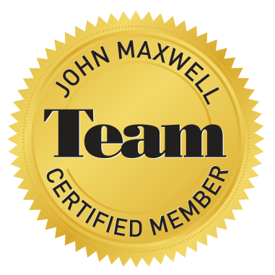
Sharon Mast, Founder
sharon@sparkss.com
610-781-1888
www.sparkss.com
Workplace Culture, Employee & Leadership Development and
Personal Growth.

