Slide 1
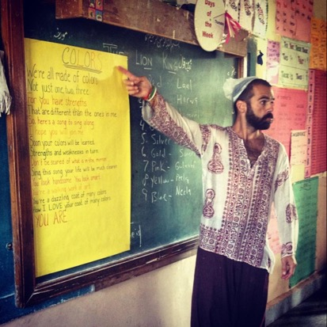
How Schools Can Transform Community
Nick Dalton, Co-Director of HANNA INSTITUTE in Sonoma, CA
Contact: ndalton@hannacenter.org

Slide 2
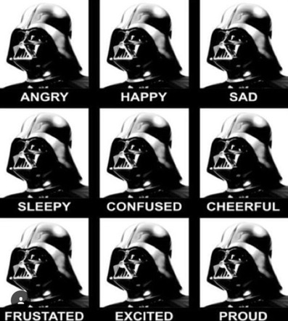
How do you teach through FEAR?

Slide 3
BREATH
HEARTBEAT
EMOTIONS

Slide 4
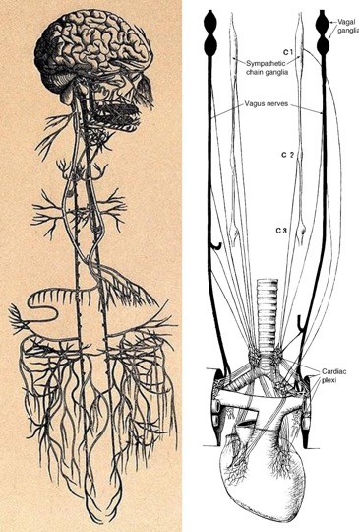
The Vagus Nerve
“What happens in VAGUS does not stay in VAGUS”
Exercise: 3/6 Breathing

Slide 5
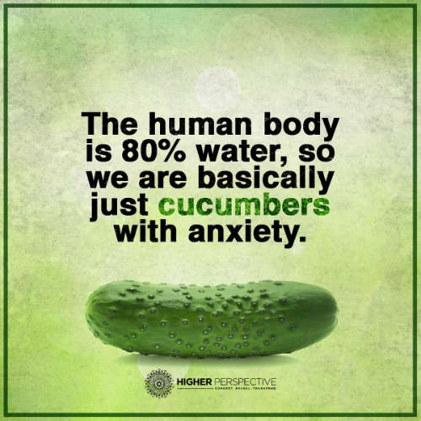

Slide 6
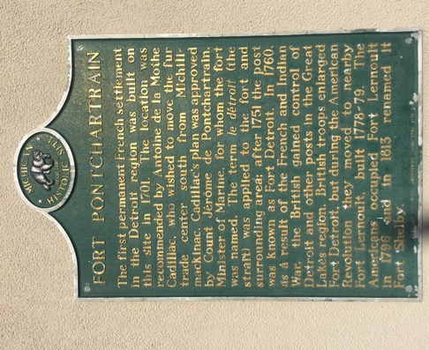
Acknowledge the History of Detroit
Anishinaabe “Three Fires”
Ojibwe
Odawa
Botawatomi
Wyandot
Iroqouis
Fox
Miami
Suak

Slide 7

TEACH FOR INDIA

Slide 8

Head Hands Heart

Slide 9




Slide 10

Were you ever a kid?

Slide 11
Neural Connections
At Birth
6 Years Old
14 Years Old
Rethinking the Brain, Families and Work Institute, Rima Shore, 1997.
Notes:
Detailed analysis of the patterns of nerve connection that form from birth to age 14 have been carried out. This slide which comes from the work of Huttenlocher shows the connections amongst the neurons at birth is not intense but that by the age of 6 the connection density is considerable. By the age of 14, the connection pattern is still greater than at birth but is less intense. The weak pathways have been cut out. This process is referred to as the wiring and sculpting of the brain. The wiring of neurons in the brain is hugely influenced by stimulation and the use of these neuron pathways. Thus, as you age, pathways that are not intensely used will disappear. What this evidence does show you is that the early period of life has a significant effect on the wiring and sculpting of the brain.

Slide 12


Notes:
Key Points
TIC practice has been studying the science of early intervention now for 20 years-the big question has been: do we even need early intervention or “will time heal all wounds” and “this too shall pass” and ”well if they had more character and strength they could get over what has happened to them”.
It turns out that early intervention-before-during-and after trauma is essential to healing and recovery BUT-you have to have a plan and a carefully designed evidence-based structure when you conduct early intervention
The primary early intervention principles required must be built in sequence starting with safety which can induce calming.
Once safety and calming are established connectedness can be fostered and maintained.
Once there is a full sense of the interrelationship between safety, calming, and connectedness the client or group can begin to discover and explore their self-efficacy or their sense that they are considered masterful in the eyes of their peers.
As self-efficacy is deepened the client or group can begin to sense a future or develop future orientation which allows them to experience hope, even in the face of further stressors, as long as the safety-calming-connectedness is maintained.
process can lead to positive behavioral change which can support pro-social development and attachment.
Lead Trainer Prompts
Tell story (example) like “The Bowling Alley”
Lead Trainer Notes
Self efficacy is self master with my peers. But the key to that is non-verbal communication, which is 60-90% of how we communicate.

Slide 13
The HOW
“The only way to change is… through a change of human consciousness and through a change of heart. Only through the arts – music, poetry, dance, painting, writing – can we really reach each other.”
(Leslie Marmon Silko, Ceremony)

Slide 14
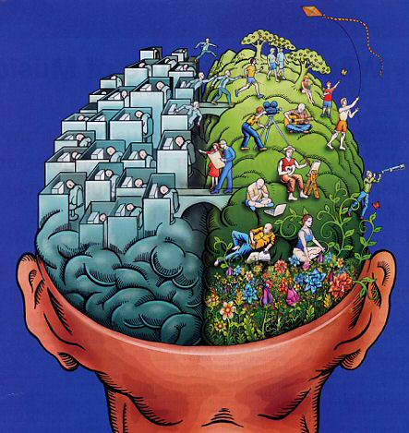
Notes:
Key Points
In order to reduce the impact of toxic stress TIC uses new research about the brain and the mind-body connection to develop successful treatment interventions
George Bush declared the 90’s the decade of the brain which allowed massive funding for brain research- which includes fMRI, pet scans, and more. (fMRI is able in real time to see blood flow change as their narrative was shared)
Point out that The brain functions at its highest level when there is fully integrated blood flow –which means equal flow: right to left; front to back; and top to bottom
Trauma exposure activates fear and threat systems which recruits blood away from the front and left sides of the brain increasing flow into the rear right quadrant of the brain in preparation for survival (hind brain – limbic system {combo of emotional and memory centers}{amygdala is a part of this}) – HAVE ANY OF YOU EVER BEEN IN AN ARGUMENT? (F word) Its not just words, its posture, vocal tone, facial expression, etc…
Therefore, blood flow integration decreases-in the service of survival-which deactivates the areas of the brain we use for communication, planning, organizing, problem solving and calming (L WORDS)
TIC approaches & TIC interventions reestablish integrated blood flow so the survivor brain can regain access to communication and future orientation and reconnect with significant attachments
10 minutes later I think OH YEAH I SHOULD HAVE SAID THIS…oh I would have gotten them if I said this
Lead Trainer Prompts
The brain decompartmentalizes under the stress of a threat response….when you feel under fire how many words do you remember?
F words are anecdotal evidence
L words – lists, logic, language, linear memory, and the biggest one LISTENING
Lead Trainer Notes
Potential for empathy to help co-regulate – first thing that an infant gets

Slide 15

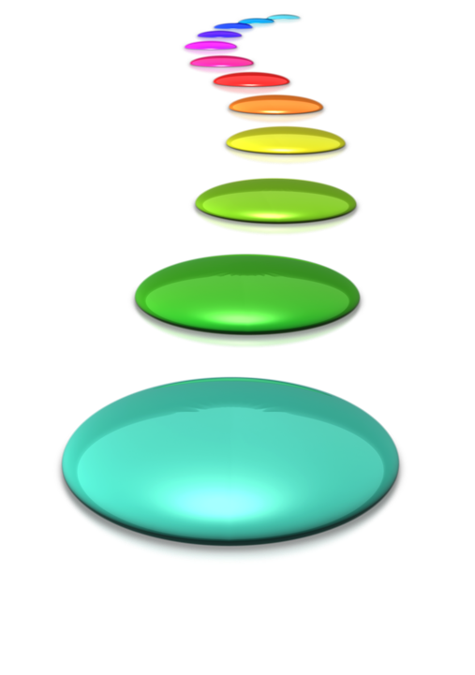
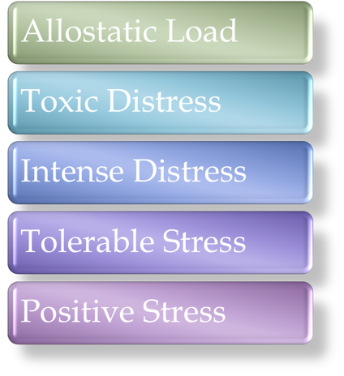
Notes:
Key Points (JUST GET THEM THINKING)
Stress gets a bad rap. But there is no such thing as just “stress”.
Stress can be experienced in numerous ways. There are stressors and stress response that are expressed along a continuum
We have survived by negotiating stressors and adapting our stress responses (ACEs)(we adapt or maladapt)
By identifying and negotiating stressors and then adapting our stress response (INA second) {Example: learning to drive a car or learning math}
Sequenced mild and moderate (positive and tolerable) stressors facilitate resiliency
GO FROM STRESS TO DISTRESS Repeated exposures to intense and toxic stressors create an overwhelming demand on the system that may result in allostasis (breakdown of your homeostasis system)
ALLOSTATIS is the opposite of HOMEOSTATIS – you are now completely out of balance {learning how to drive with someone who is constantly harping on you…}
Can somebody give me an example of
positive stress? (Getting married…..the second time)
Tolerable stress? (Going through the work day….booked or a little bit overbooked)
Intense Distress (Visiting in-laws)
Toxic Distress (Prolonged….sleep deprivation, irritability, isolation from friends, ongoing headaches)
Allostatic Load (imagine a bridge made out of bamboo…pile bricks on)
Lead Trainer Prompts
Now we have been talking in regards to individuals, but do you see this same thing happen in a group? A community or workplace? Why do you think that is? (transition)
Lead Trainer Notes
(LT’s add in personal notes/reminders)

Slide 16
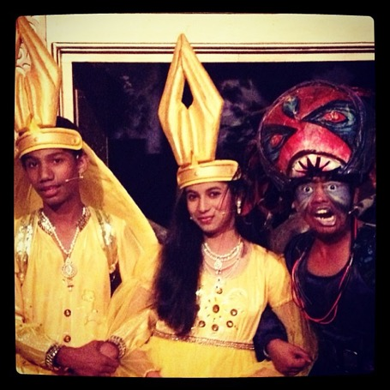
MAYA: The Musical

Slide 17
DEFINITION OF RESILIENCE
  “positive adaptation despite adversity” (Fleming and Ledogar, 2008)
  “Children are not resilient.
  Children are malleable.” (Perry, 1997)
  Metis: Resourcefulness (Kirmayer, et. al, 2011)

Slide 18
The Foundation of TIC
How do we decrease the use of
1) Coercion
2) Restraint
3) Seclusion
4) Isolation
How do we manage relationships without the use of aggression?
Notes:
Key Points
This is the key point for trauma informed care: How do we manage our relationships without using aggression to make people stay attached to us ?
Or to make people (and clients) behave the way we want them to behave
Reduction of these four aggression “techniques” is the primary goal of all trauma informed and resiliency focused programing
Beware: Many programs do make claims that they are trauma informed. The litmus test is whether these programs truly understand and operationalize this primary goal.
Lead Trainer Prompts
Lead Trainer Notes
(LT’s add in personal notes/reminders)

Slide 19
Trauma Informed Care:
Consider Cultural and Historical Trauma
Understand and Recognize the Widespread Impact of Trauma and Trauma’s Impact on Students, Staff and Community
Reduce Practices that May Result in Re-Traumatization
Collaboration, Empowerment, Voice and Choice
Transparency and Shared Resources
Establish Opportunities for Peer Support
Align All Policies And Practices With Trauma-Informed Care, Restorative, and SEL Goals

Slide 20

Culture eats policy EVERY TIME
Religion (5 religions and languages spoken)
Cultural (s)heroes
  Violence in culture based on oppression
    Pro-Social versus Competitive
1st Generation students and city dwellers
Shame based on Gender Norms

Slide 21
The word IMPOSSIBLE says
IM POSSIBLE
Student Breakdown
Assistive Technologies
30 students from 15 schools
Some students travel 1 hour each way for class
Age difference is 9-15
Can only teach in English
12 Hours / week
No Budget
Process over Content
Stimulate the Senses
Intermediary Objects

Slide 22
TEACHER DEVELOPMENT
10 teachers: Constant development in content, pedagogy, and social emotional competencies
WHAT DOES THAT LOOK LIKE IN MOTION
  Weekly Arts Integration Collaboration
  Weekly SEL/RP (PD)
  Unpack every class

Slide 23
Community & Family Engagement
Homework (Values in Action, Cultural Enrichment, Transgenerational Wisdom)
3 Home Visits per week
Monthly Student-led Family Workshops
Community Performances
Community Outreach

Slide 24
COURAGE COMPASSION WISDOM
EXPERIMENTS
ARTS INTEGRATION
Question Curriculum
Restorative Practices
Non-Verbal Communication (Affect Psychology, Masks, etc…)
Weekly Community Homework
Music component
Visual Arts Component
Meditation/Heartfulness
Movement Component
(bi-lateral stimulation)

Slide 25
EXERCISE EXAMPLES
Music Integration
Cross Curricular Teaching
Transitions
The Magic of 4/4
Instrumental music while studying
Rhythm and Movement (Poems)
Limbic SPEED games
Lyric Mosaic (Don’t Worry Be Happy)
Cubism Self-Portraits (Picasso)
Re-Written Songs for Curriculum Requirements (Yo Yo Honey Singh, African Colonies)

Slide 26
FORM into ACTION
“Establish Being”
OPENING/MEDITATION
BEING Activity
This moment helps ground in the space and settle their minds. It starts with re-establishing the co-created guidelines of the space through song (Created in Class 1). It then continues through meditation or complete breathing/meditation which will help rid the mind-body connection of cortisol and stress by stimulating the vagal and nervous system.
This will be a rotating series of exercises to help each brain-body type reboots based on their individual physiological needs.
Examples: Authentic Movement, Yoga, Contact Improvisation, Guided Movement Sequences, Vocal/Breath exercises with movement, Restorative Exercises.

Slide 27
PERFORM ACTION
SPARK/EXPOSURE: (PROACTIVE CIRCLES)
This is where homework will be discussed, exposure films will be discussed in dyads and group work, and the theme for the week will be explored in multiple ways including discursive dialogue and question curriculum. It will also involve a large visual art component and Restorative Practices activities. This is also where GOALS for the class will be established.
MINI-ACTIVITY: (CIRCLE or CLASSROOM FORMAT)
This section will include vocabulary, themes, and fundamental building blocks for what will be covered in the MAIN-ACTIVITY. This could include codifying a series of movements from the BEING Activity, co-creating a framework for the SHAME/NON-VERBAL communication being navigated through the MAIN-ACTIVITY, or further discursive dialogue around the topic of the day.

Slide 28
TAKING ACTION into COMMUNITY
MAIN-ACTIVITY: (CLASSROOM FORMAT)
  This is the primary creation portion of the class. It will involve time in groups as well as co-creating in a lab setting with the entire class.
CLOSING: (CIRCLE FORMAT)
Starting with a mini-meditation or Heartfullness moment, this is an opportunity to reflect on what happened in class that day. This will include questions to both students and teacher:
“How did you do today on a scale of 1-5 based on goals? Why?”
“How did we do as a class today? Why? Give examples…” “How did the guides do today? Why? Give examples…”
This area will also include shoutouts of moments that were enjoyed as well as a birthday circle sharing one thing they love about the birthday celebrator.

Slide 29
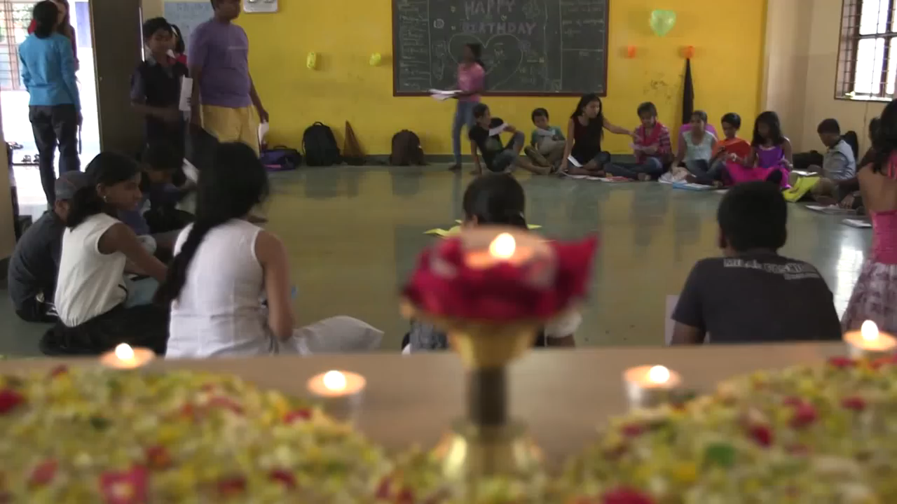
9 months in…

Slide 30
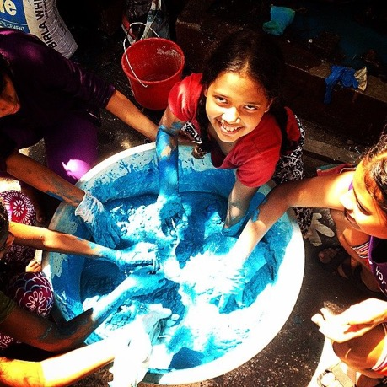
The Proof in the Pudding

Slide 31

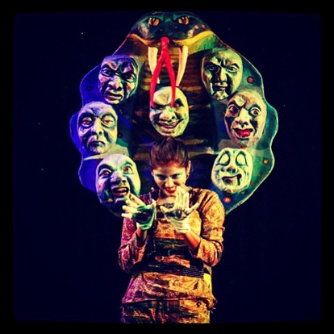
MAYA: The Musical

Slide 32
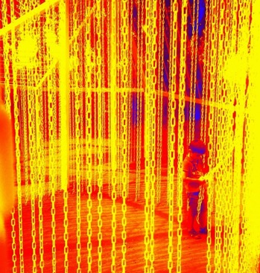
HANNA INSTITUTE
SONOMA CHARTER SCHOOL
  RAINBOWDANCE (K-3)
  Teacher Development
  Clinician
  Community Engagement
RESILIENT SONOMA
  Tipping Point Grant
  (Trauma Informed Care Training)
  Vintners Association Grant
  (Spanish Language Programming)

Slide 33
“You deserve the best. Never feel unworthy or not justified in having the best. I tell you, this is your heritage. But, you have to accept it. You have to expect it. And, you have to claim it. To do so is not demanding too much.”
~Swami Brahmananda Sarawati

Slide 34
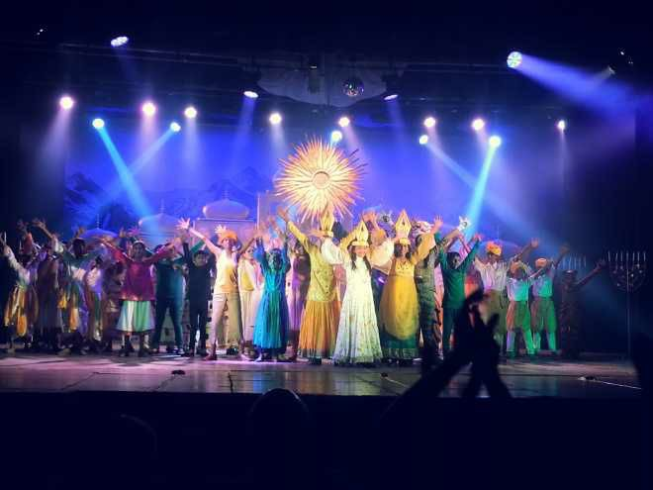
Contact: ndalton@hannacenter.org

